Slide 1

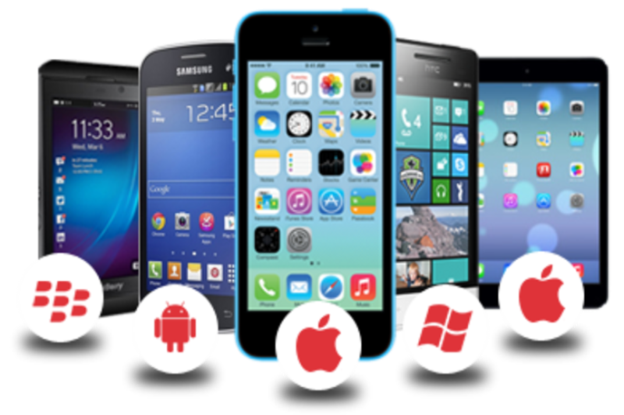
What is android?

Slide 2
Android Studio
Android Studio is the official integrated development environment (IDE) for Google's Android operating system
Android Studio was announced on May 16, 2013 at the Google I/O conference
Built on JetBrains' IntelliJ IDEA software and designed specifically for Android development
Available for download in Windows, MacOS and Linux based operating systems
It is a replacement for the Eclipse Android Development Tools (ADT) as primary IDE for native Android application development

Slide 3
Android Studio(contd…)
Android Studio supports Gradle(gradle is basically a build tool)-based build
Gradle is a custom build tool used to build android packages (apk files) by managing dependencies and providing custom build logic.
APK file (Android Application package) is a specially formatted zip file which contains. Byte code. Resources (images, UI, xml etc)

Slide 4
Software Development Kit (SDK)
Android Software Development Kit (SDK),is a suite of software tools required to build Android apps
Android SDK is the part of Android Studio
It makes use of the Java SE Development Kit (JDK)
SDK contains a debugger, libraries, an emulator, documentation, sample code, and tutorials.

Slide 5
Native Development Kit (NDK)
Use C/C++ for development
primarily for performance critical components

Slide 6
Android App Testing
Android Apps can be tested using
Android Virtual Device(AVD)
Physical Device

Slide 7
Android Virtual Devices (AVDs)
An Android Virtual Devices (AVDs) is an emulator instance that enables you to model an actual device.
In emulation, computer sets aside a block of memory to reproduce the environment found on the device that the emulator is emulating.
Android Virtual Device Manager allows you to create Android Virtual Devices which you can then run to emulate a device on your computer.
Used for testing your Android applications
Each AVD consists of a hardware profile, a mapping to a system image, as well as emulated storage, such as a secure digital (SD) card.

Slide 8
Android Virtual Devices (AVDs) contd…
You can create as many AVDs as you want in order to test your applications with several different configurations
This testing is important to confirm the behavior of your application when it is run on different devices with varying capabilities
There is an excellent third-party Android emulator on the market called Genymotion
The Genymotion emulator is free for noncommercial purposes and performs very well.
you can download the Genymotion emulator from genymotion.com

Slide 9
Physical Android Devices
Developing apps on a physical Android device is far more desirable
AVDs are useful for emulating specific devices, particularly those that you do not have on hand
The connection between your computer and your Android device is established by using a server called the Android Debug Bridge (ADB)
probably requires a USB driver of android device If your computer does not recognize your Android device when connected
On your Android device, enable Developer Options and USB Debugging

Slide 10
Anatomy of an Android Application
In the Android tab on the left in the android studio, you will notice two main sections
App
Gradle Scripts

Slide 11
Anatomy of an Android Application - app
App folder contains
AndroidManifest.xml
XML based file manifest file for your Android application.
pulls together the various elements that comprise an application
outlines the activities, services, broadcast receivers, data providers and permission that make up the complete application.
src — Contains the .java source files for your project. You will write the code for your application in this file.

Slide 12
Anatomy of an Android Application – app(contd…)
res folder
This folder contains all the resources used in android application such as the strings, images, fonts and colors that appear in the user interface together with the XML representation of the user interface layouts.
It also contains a few other subfolders: drawable, layout, mipmap and values

Slide 13
Anatomy of an Android Application- Gradle Scripts
Gradle Scripts has
build.gradle(Project:AppName) file contains configuration for all projects and modules in the application.
build.gradle(Module:app) file contains specific configuration for the module it’s included with.

Slide 14
Thank You

